Slide 1
STUDENT MARKS ANALYSER
Presented by:
Gangumalla Karthikeya Reddy(25211A05H1)
Ganji Bhanu Teja(25211A05H2)
Ganteda Jyothsna(25211A05H3)
Ganogapenta Govardhan Reddy(25211A05H4)

Slide 2

Problem Statement:
Challenges in Manual Marks Analysis
Teachers and students face difficulty in analyzing marks manually
Time-consuming to calculate totals, averages, and grades
Chances of human errors in calculations
Hard to track student performance over time

Slide 3
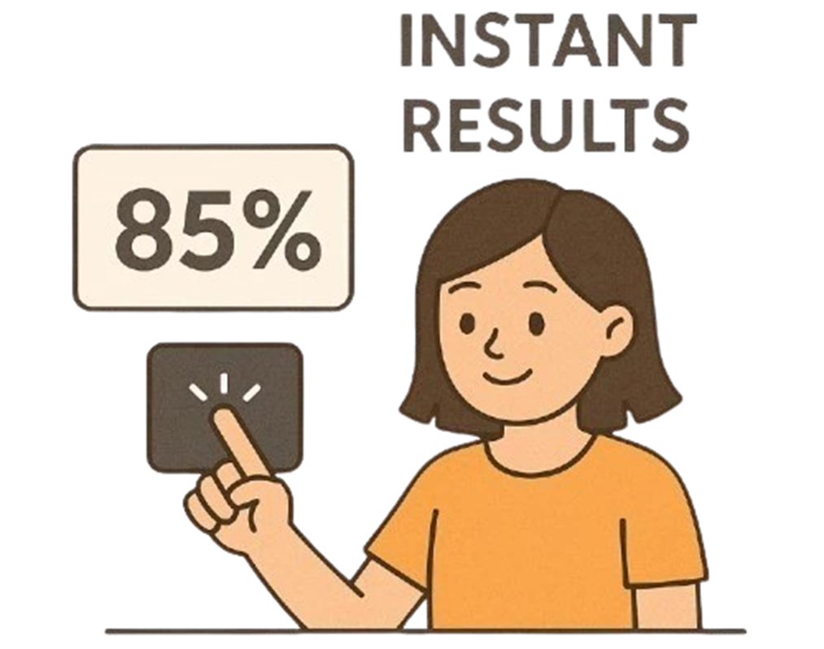
Solution Overview
Our Proposed System
Developed a Student Marks Analyzer using C language
Automates calculation of:
Total marks
Average marks
Grades
Provides a simple and efficient interface
Reduces errors and saves time

Slide 4
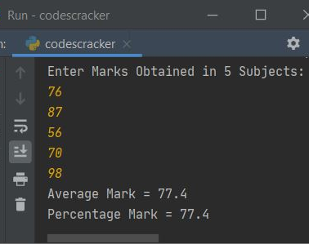
Key features
Features of the System
Input marks of multiple students
Automatic calculation of total and average
Grade assignment based on performance
Display student-wise results clearly
Easy to use command-line interface

Slide 5

Advantages of the system
Why Our System is Useful
Accuracy – eliminates manual calculation errors
Time-saving – quick result generation
User-friendly – simple input/output
Lightweight – runs easily on any system
Educational tool – helps understand C programming concepts

Slide 6
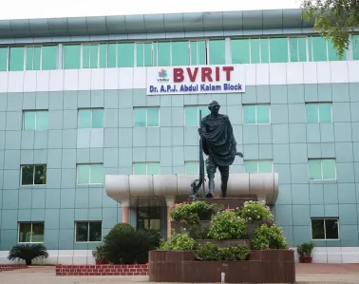
Project Uses:
Schools and colleges for result processing
Students to analyze their performance
Teachers to track class performance
Can be extended to large-scale result systems

Slide 7
Working of the System
How the System Works
User selects “Analyze Student” option
Enters student name and Mid-1 marks for all subjects
System uses AI-based logic to:
Predict Mid-2 marks
Calculate required semester marks
Computes:
Total marks for each subject
Overall average
Displays complete analysis and performance report

Slide 8
Code Structure and Flow
Program Structure
Structures
struct Student → stores marks, totals, average
Arrays
Subject names stored in subjects[]
Functions Used
analyze_student() → main logic
predict_mid2() → AI prediction
required_sem() → calculates required marks
print_*() → display functions
File Handling
Saves student data in "ai_students_db.txt"
Menu-driven program
User and Admin options

Slide 9
How does the code Work
Internal Logic Explanation
Program starts with a menu-driven interface
Takes input of Mid-1 marks
Uses:
predict_mid2() → adds trend + random factor
Finds best mid marks using max()
Calculates:
Internal marks = 30% of best mid
Required semester marks for target (85)
Computes total marks and average
Displays:
Subject-wise analysis
Overall performance
Study plan & recommendations

Slide 10
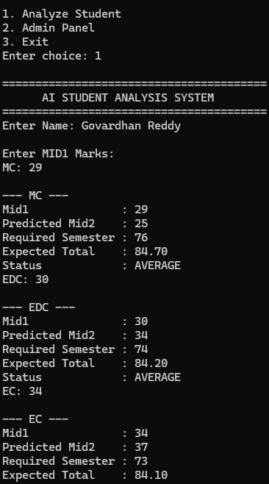
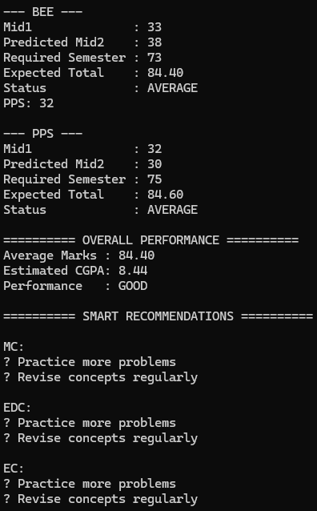
Output
Output of the System
Displays for each subject:
Mid-1 marks
Predicted Mid-2
Required semester marks
Expected total
Status (Strong / Average / Weak)
Shows:
Overall average
Estimated CGPA
Provides:
Smart recommendations
Study plan
Career opportunities
Stores data in file for future analysis

Slide 11
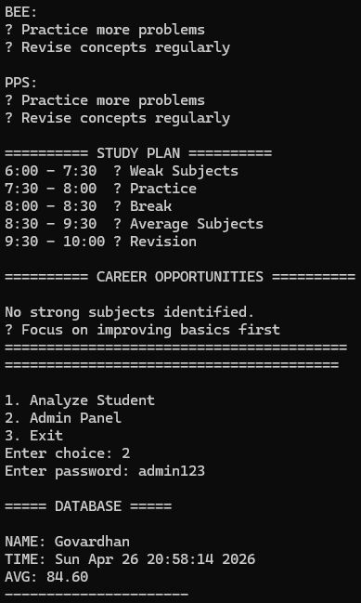
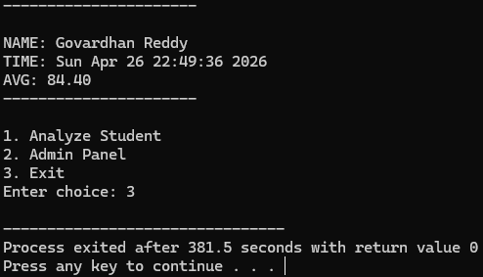

Slide 12
Conclusion
Student Marks Analyzer simplifies result processing
Reduces errors and improves efficiency
Useful for both students and teachers
Good project for learning programming concepts

Slide 13
Thank you
Presented by:
Gangumalla Karthikeya Reddy(25211A05H1)
Ganji Bhanu Teja(25211A05H2)
Ganteda Jyothsna(25211A05H3)
Ganogapenta Govardhan Reddy(25211A05H4)

